Slide 1
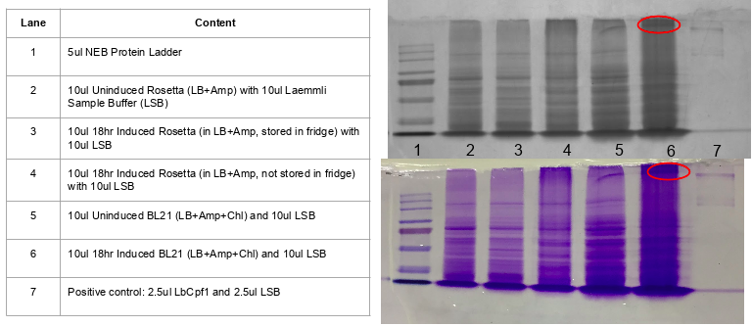

Slide 2
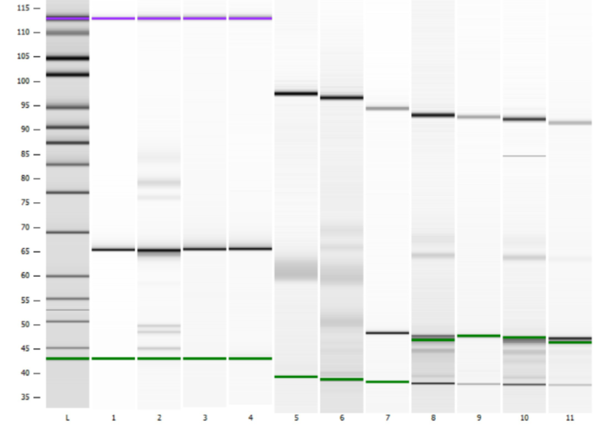

Slide 3
Lane | gRNA-template complex
1 | rs334_C (control) – no guide
2 | rs334_C
3 | rs334_T (control) – no guide
4 | rs334_T
5 | HBBwt (control) – no guide
6 | HBBwt
7 | rs75389940_G (control) – no guide
8 | rs75389940_G
9 | WT_CF (control) – no guide
10 | WT_CF
11 | Template wt_CF + guide rs75389940_G

Slide 4
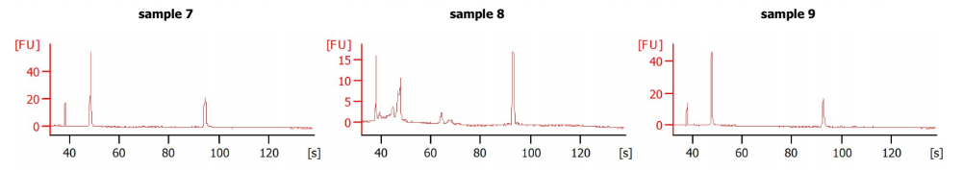
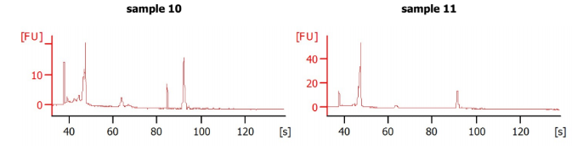
7 | rs75389940_G (control) – no guide
8 | rs75389940_G
9 | WT_CF (control – no guide
10 | WT_CF
11 | Template wt_CF + guide rs75389940_G

